Slide 1
CLC 6 Dijkstra’s Algorithm
Ryan Coon Allen Atkins Carrie Assalone

Slide 2
Dijkstra’s Algorithm
Dijkstra's Algorithm works on the basis that any subpath B -> D of the shortest path A -> D between vertices A and D is also the shortest path between vertices B and D.
Dijkstra's algorithm allows us to find the shortest path between any two vertices of a graph.
It differs from the minimum spanning tree because the shortest distance between two vertices might not include all the vertices of the graph.
Dijkstra's Algorithm works on the basis that any sub path B-> D and the shortest path A -> D between vertices A and D is also the shortest path between vertices B and D.
Dijkstra used this property in the opposite direction i.e., we overestimate the distance of each vertex from the starting vertex. Then we visit each node and its neighbors to find the shortest sub path to those neighbors.
The algorithm uses a greedy approach in the sense that we find the next best solution hoping that the result is the best solution for the whole problem.

Slide 3
Reachability
Dijkstra's Algorithm works on the basis that any subpath B -> D of the shortest path A -> D between vertices A and D is also the shortest path between vertices B and D.
In a graph, the ability to get from one vertex to another vertex is called reachability.
It is possible when there is a path from one vertex to another vertex
Here the path is start from vertex “Greenlee” and ends with the vertex “La Paz”

Slide 4
Shortest Path
Dijkstra's Algorithm works on the basis that any subpath B -> D of the shortest path A -> D between vertices A and D is also the shortest path between vertices B and D.
In a graph, it is about to find the path between 2 vertices, such that the sum of the weights of its edges is minimized.
Shortest path is nothing but a path with minimum weight of an edge.
In the given graph, from vertex “Greenlee” to vertex “La Paz” it is not searchable. So we go to next for the shortest path.
From “Greenlee”, if we go with the edge cost=4, “La Paz” is not searchable. So again we go to the next for the shortest path.
If we go to the edge with cost=16, “La Paz” is searchable.
Then the graph is traversed by using Dijkstra’s Algorithm.

Slide 5
Procedure
Dijkstra's Algorithm works on the basis that any subpath B -> D of the shortest path A -> D between vertices A and D is also the shortest path between vertices B and D.
Initially the source distance = 0 and all remaining nodes cost = ∞
From the source, try to relay every outgoing edge from the chosen node(Greenlee) Here the chosen node must be with the least amount of cost.
Then travel the path from the chosen node and replace with the lest weight.
You do not need to consider a previously chosen node, as the path is already computed.
By following the steps, travel from source to destination.

Slide 6
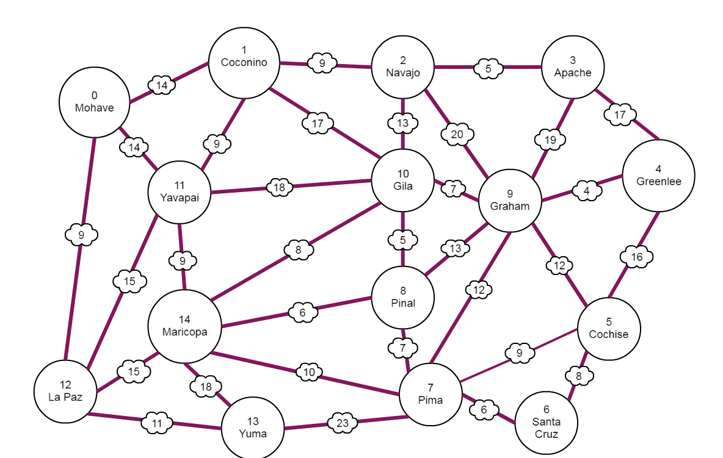
Notes:
Example paths
Greenlee – cochise - santa cruz – pima – Yuma – la paz = 64
Greenlee – apache – Navajo – gila – pinal – Maricopa – la paz = 58
Greenlee – apache – Navajo – gila – yavapai – la paz = 68
Greenlee – graham – pinal – Maricopa – la paz = 38

Slide 7
Big 0 Notation
Dijkstra's Algorithm works on the basis that any subpath B -> D of the shortest path A -> D between vertices A and D is also the shortest path between vertices B and D.
Let n be the number or vertices and m be the number of edges.
In Dijkstra's algorithm, we have O(n) delete mins and O(m) decrease keys, with each costing O(log n), and the total run time will be O(log(n)(m + n)
i.e.
O(log(15)(32 + 15)) = O(15 + 32 log 15) = 52.6 Vertices = 15
Edges = 32

